Slide 1


8. GLMs and Regression Tree
8.1 Logistic Regression
Mar 27, 2018
PRESENTER : JongYun Kim
UNIST Autonomous System LAB
Address. 112-#810, 50 UNIST-gil, Ulju-gun, Ulsan, 44919, South Korea
Tel. +82 52 217 2368 Web. https://sites.google.com/site/aslunist/

Slide 2
CONTENTS
1. Introduction
02
4. Into Exponential Family
21
- Idea of logistic regression
2. Logistic Transformation
08
5. Example : cell infusion
27
3. Example : dose response
13
6. Example : spam filter
35

Slide 3
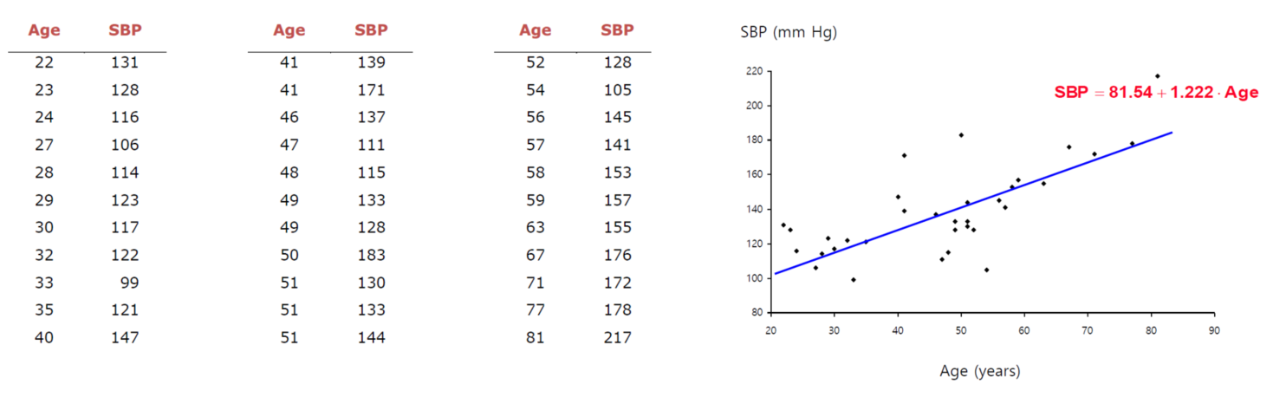
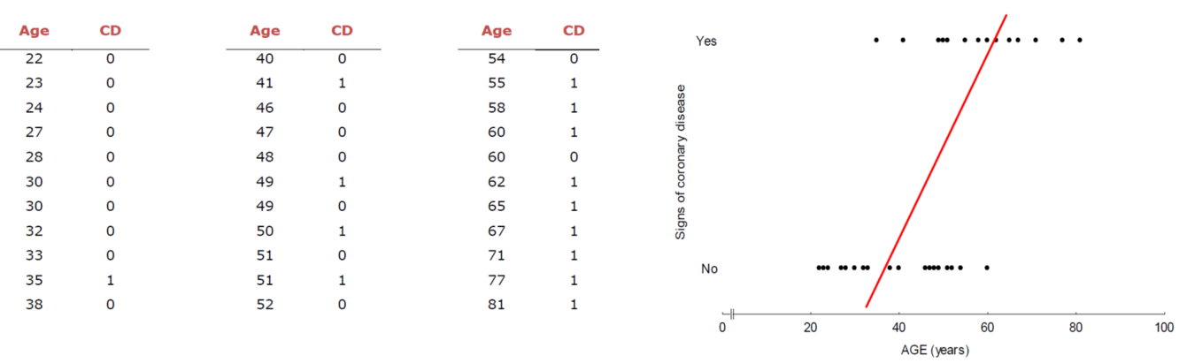
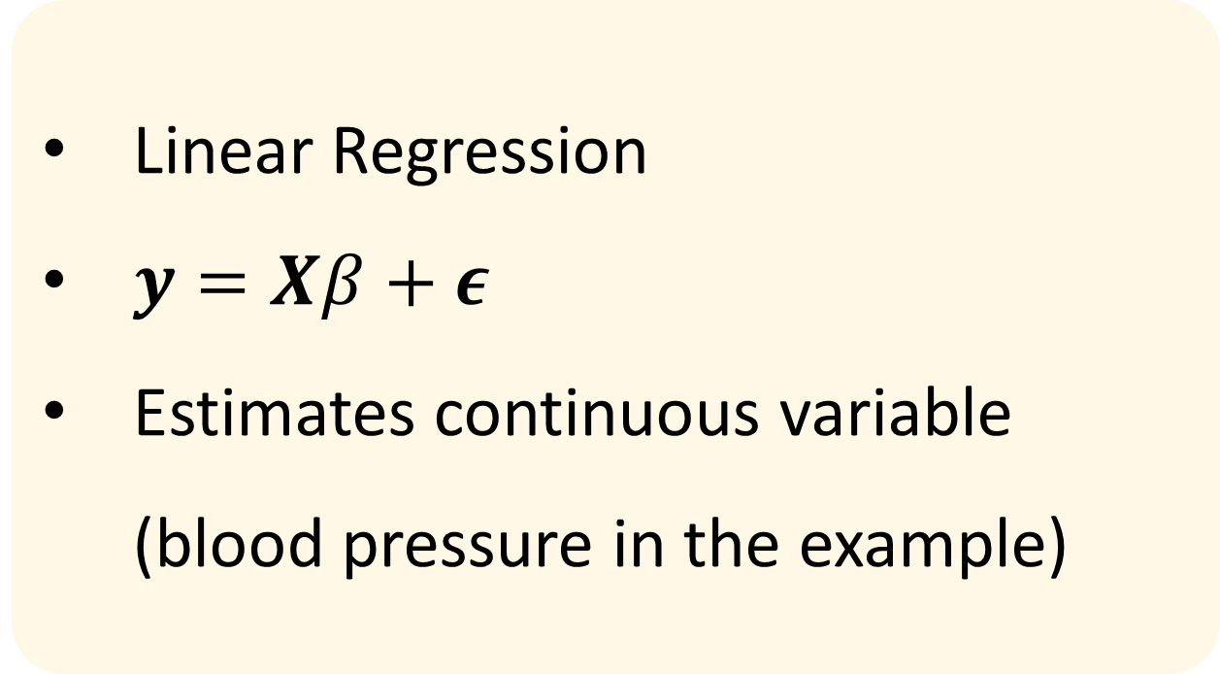
Introduction
Linear Regression
$y=Xβ+ε$
Estimates continuous variable (blood pressure in the example)
What about estimating categorical (count) variable or probability (proportion) ??
Could be {0, 1} or [0, 1]
If applying linear regression, ……?!

Slide 4
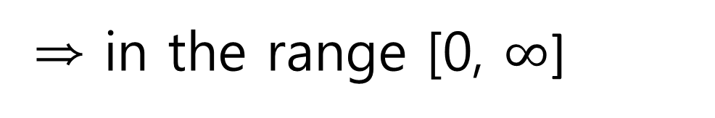
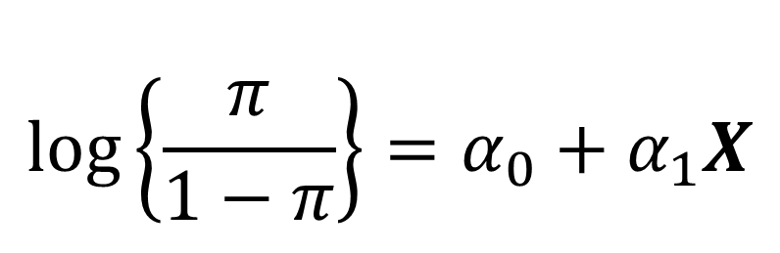
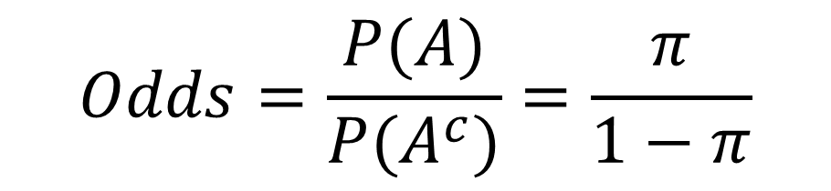
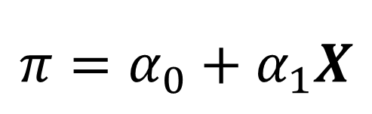
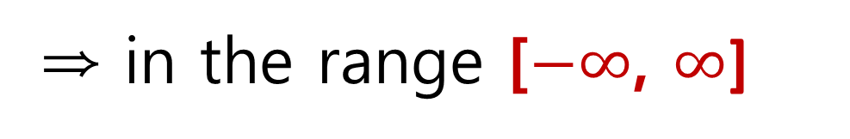
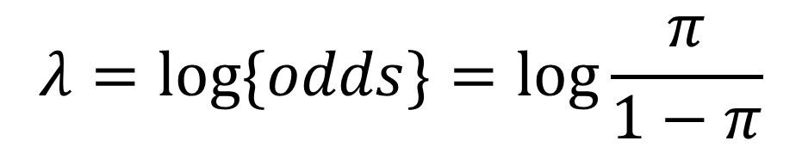
Odds and Logistic Transformation
Logit parameter
$$Odds=\frac{P(A)}{P(A^{c})}=\frac{π}{1−π}$$
$$λ=\log{\{odds\}}=\log{\frac{π}{1−π}}$$
⇒ in the range [0, $∞$]
⇒ in the range [$−∞$, $∞$]
Logistic transformation
$$\log\left\{\frac{π}{1−π}\right\}=α_{0}+α_{1}X$$
$$π=α_{0}+α_{1}X$$
Now, we can consider count or proportion data as holding linear regression frames

Slide 5

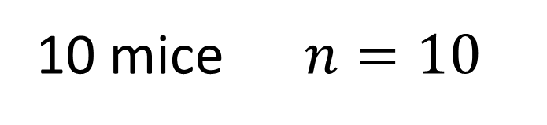
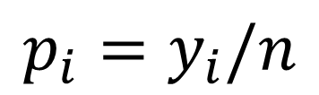
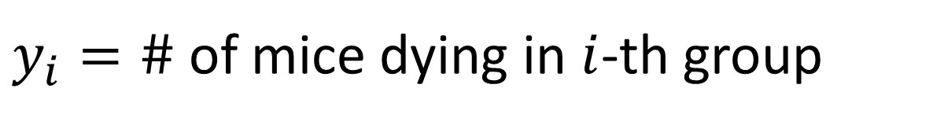
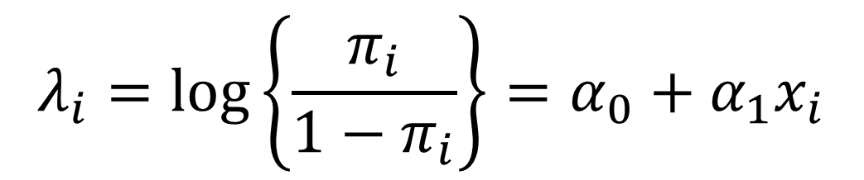
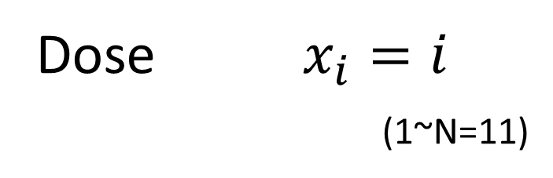

Example : dose response
10 mice $n=10$
injection
$y_{i}=\#$ of mice dying in $i$-th group
Dose $x_{i}=i$
(1~N=11)
$$p_{i}=y_{i}/n$$
Group $i$
We are going to model $y_{i}$ as independent binomials
Assume that the logit follows linear function of dose
$$λ_{i}=\log\left\{\frac{π_{i}}{1−π_{i}}\right\}=α_{0}+α_{1}x_{i}$$

Slide 6
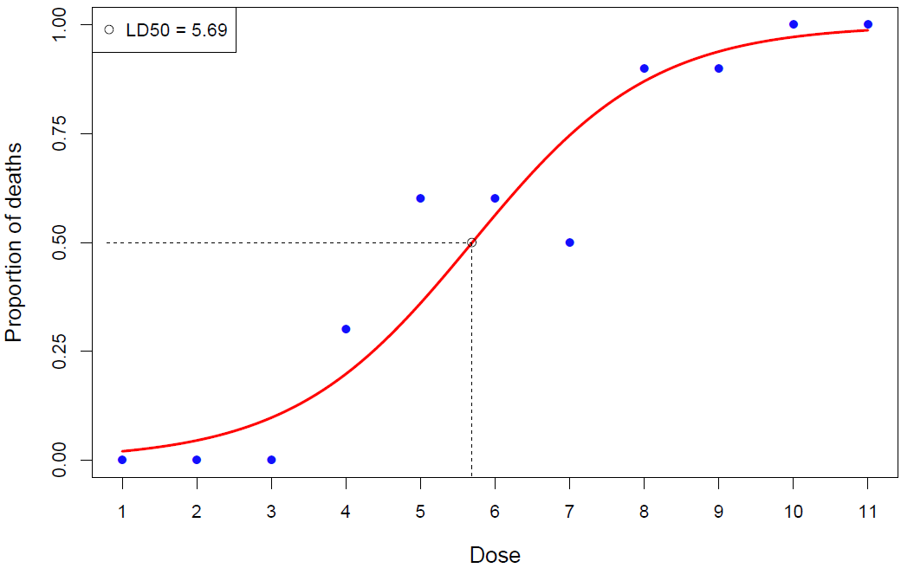
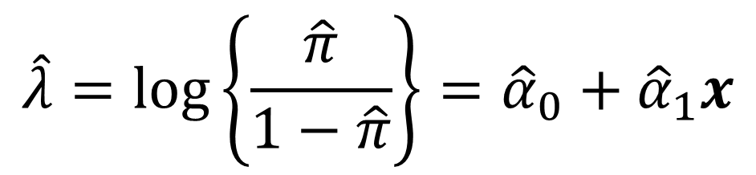
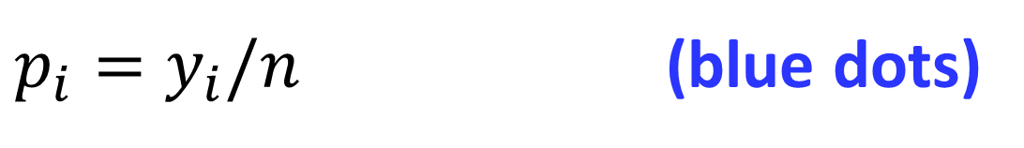
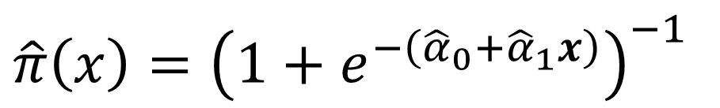
Example : dose response
10 mice $n=10$
injection
$y_{i}=\#$ of mice dying in $i$-th group
Dose $x_{i}=i$
(1~N=11)
$p_{i}=y_{i}/n$ (blue dots)
Group $i$
MLE provides (${\hat{α}}_{0},{\hat{α}}_{1}$) which yields the following equation
$$\hat{λ}=\log\left\{\frac{\hat{π}}{1−\hat{π}}\right\}={\hat{α}}_{0}+{\hat{α}}_{1}x$$
And we finally obtain the linear logistic regression curve
$\hat{π}\left(x\right)={\left(1+e^{−\left({\hat{α}}_{0}+{\hat{α}}_{1}x\right)}\right)}^{−1}$

Slide 7
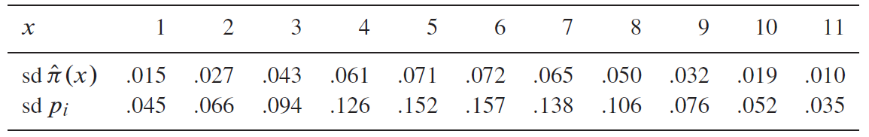
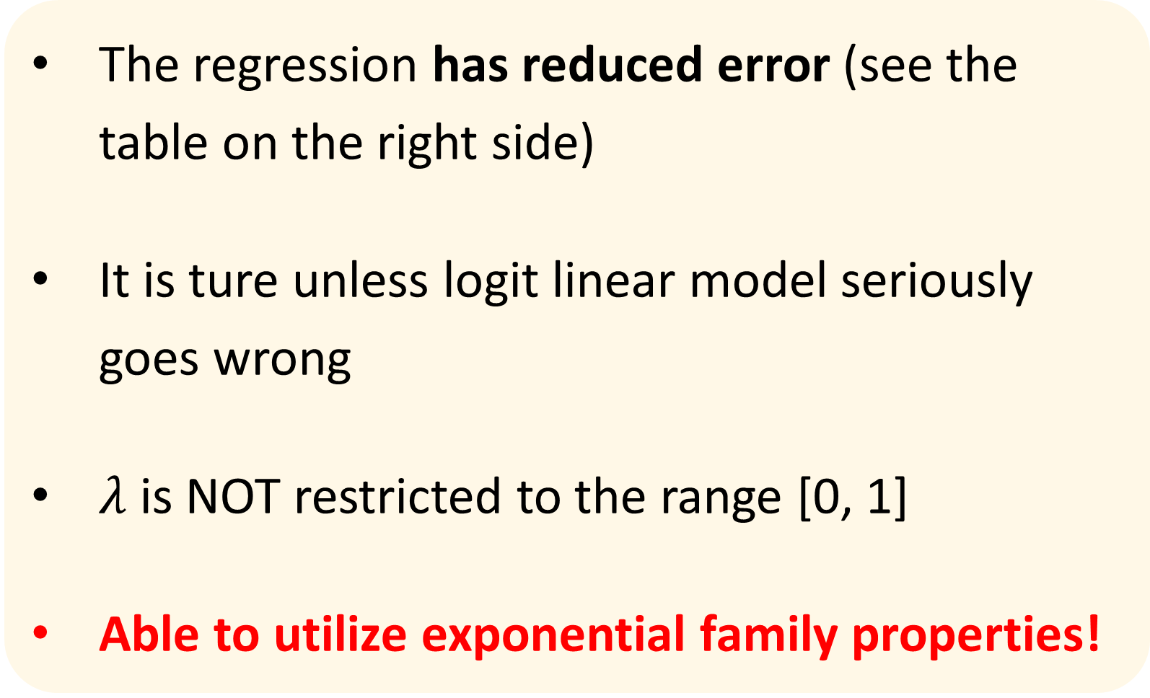
Note : dose response
The regression has reduced error (see the table on the right side)
It is ture unless logit linear model seriously goes wrong
$λ$ is NOT restricted to the range [0, 1]
Able to utilize exponential family properties!

Slide 8
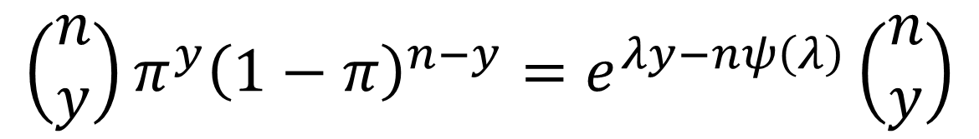
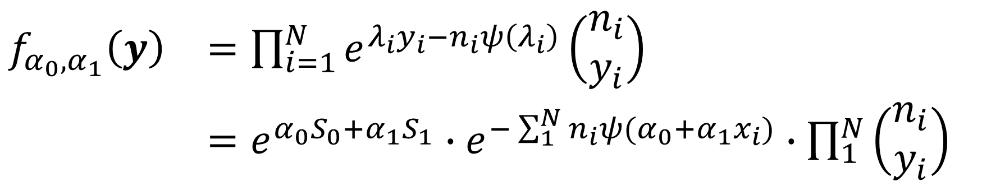
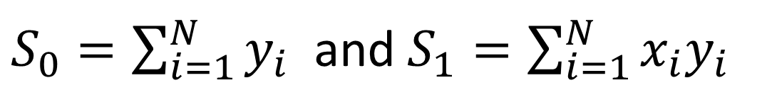
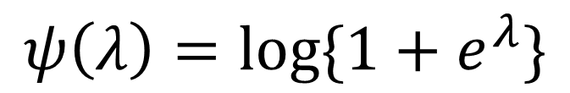
Merging Into Exponential Family
The probability density function of Bi($n, y$) is given
$$\left(\begin{matrix}n \\ y\end{matrix}\right)π^{y}{\left(1−π\right)}^{n−y}=e^{λy−nψ\left(λ\right)}\left(\begin{matrix}n \\ y\end{matrix}\right)$$
→ one parameter exponential family (see chapter 5.5 ; eq 5.54 or 5.46)
, where
$$ψ\left(λ\right)=\log{\{1+e^{λ}\}}$$
The independence of the data gives the probability density of full data set $y$ as a function of ($α_{0}, α_{1}$),
$\begin{matrix}f_{α_{0},α_{1}}\left(y\right) & =\prod_{i=1}^{N}{e^{λ_{i}y_{i}−n_{i}ψ\left(λ_{i}\right)}\left(\begin{matrix}n_{i} \\ y_{i}\end{matrix}\right)} \\ & =e^{α_{0}S_{0}+α_{1}S_{1}}∙e^{−\sum_{1}^{N}{n_{i}ψ(α_{0}+α_{1}x_{i})}}∙\prod_{1}^{N}{\left(\begin{matrix}n_{i} \\ y_{i}\end{matrix}\right)}\end{matrix}$
, where
$S_{0}=\sum_{i=1}^{N}{y_{i}}$ and $S_{1}=\sum_{i=1}^{N}{x_{i}y_{i}}$

Slide 9
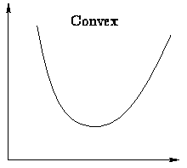


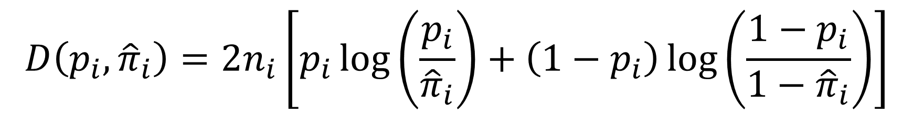
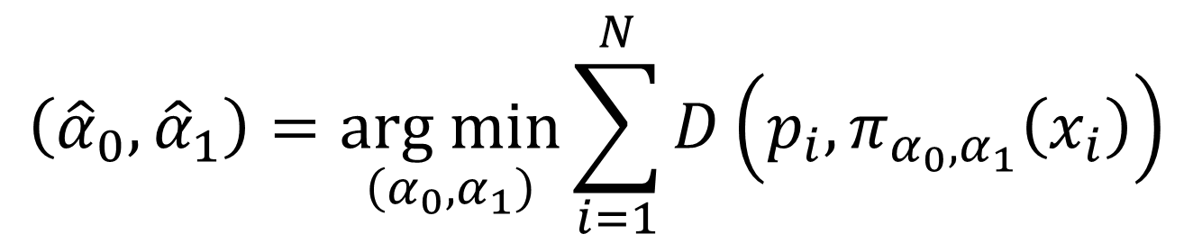
Merging Into Exponential Family
D
Suppose that the deviance is given as follows
$$D\left(p_{i}, {\hat{π}}_{i}\right)=2n_{i}\left[p_{i}\log\left(\frac{p_{i}}{{\hat{π}}_{i}}\right)+\left(1−p_{i}\right)\log\left(\frac{1−p_{i}}{1−{\hat{π}}_{i}}\right)\right]$$
$$p_{i}$$
$${\hat{π}}_{i}$$
The deviance gives us the intuition : it is zero at ${\hat{π}}_{i}=p_{i}$, otherwise it increases as ${\hat{π}}_{i}$ departs further from $p_{i}$
The logistic regression MLE value $\left({\hat{α}}_{0},{\hat{α}}_{1}\right)$ has to do with minimizing the total deviance between $p_{i}$ and ${\hat{π}}_{i}=π_{α_{0},α_{1}}\left(x_{i}\right)$
$$\left({\hat{α}}_{0},{\hat{α}}_{1}\right)=\underset{\left(α_{0},α_{1}\right)}{arg min}{\sum_{i=1}^{N}{D\left(p_{i},π_{α_{0},α_{1}}\left(x_{i}\right)\right)}}$$

Slide 10
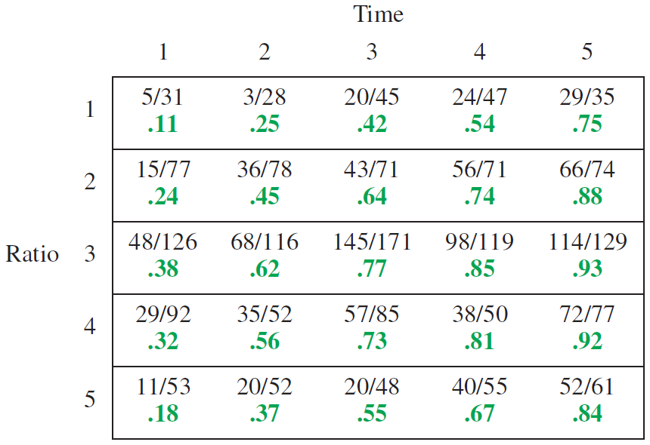
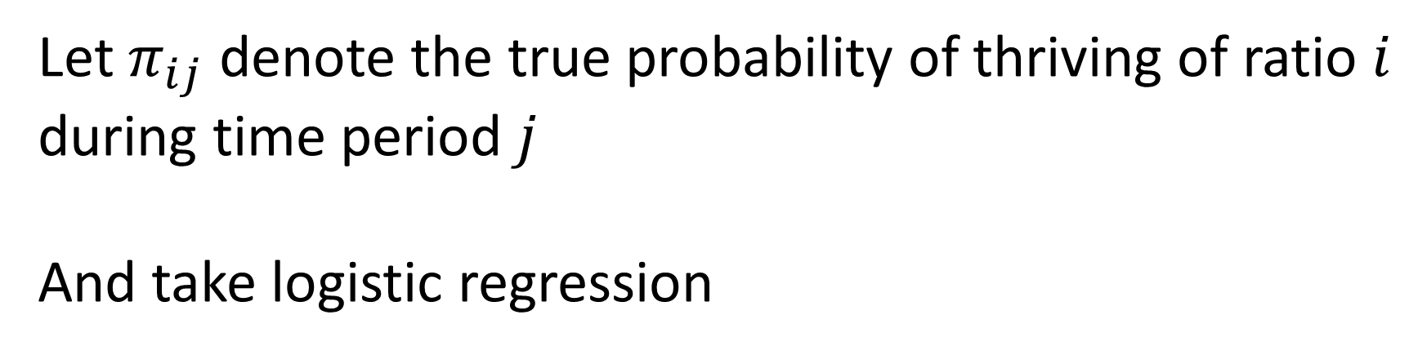

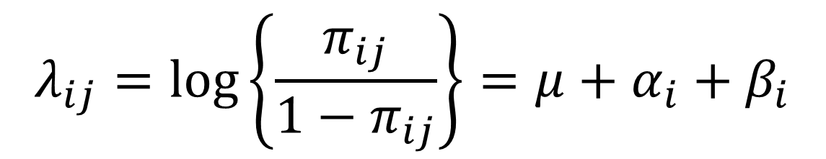



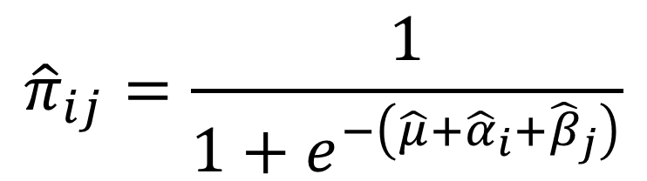
Example : cell infusion
$$j$$
Let $π_{ij}$ denote the true probability of thriving of ratio $i$ during time period $j$
And take logistic regression
data
$$p_{ij}$$
$$λ_{ij}=\log\left\{\frac{π_{ij}}{1−π_{ij}}\right\}=μ+α_{i}+β_{i}$$
$$i$$
$${\hat{π}}_{ij}$$
estimated
MLE and the data set {$p_{ij}$} give estimation ${\hat{π}}_{ij}$ as follows
$${\hat{π}}_{ij}=\frac{1}{1+e^{−\left(\hat{μ}+{\hat{α}}_{i}+{\hat{β}}_{j}\right)}}$$
Cell infusion data; human cell colonies infused with mouse nuclei in five ratios over 1 to 5 days and observed to see whether they did or not thrive.

Slide 11
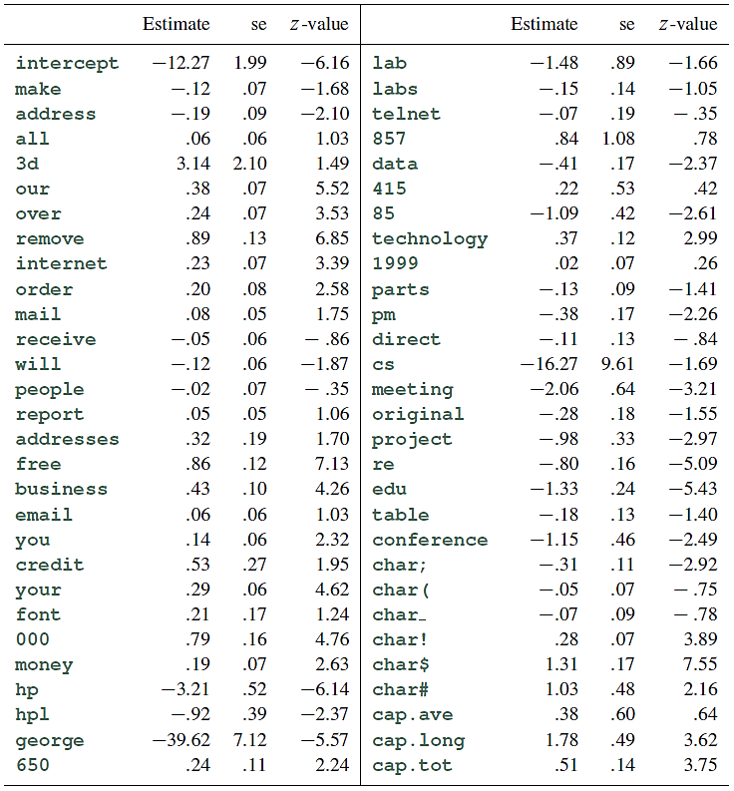
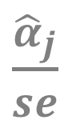
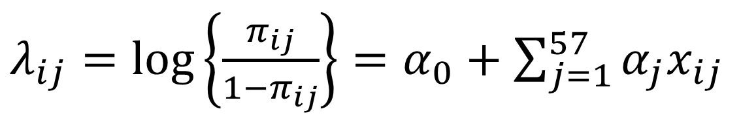
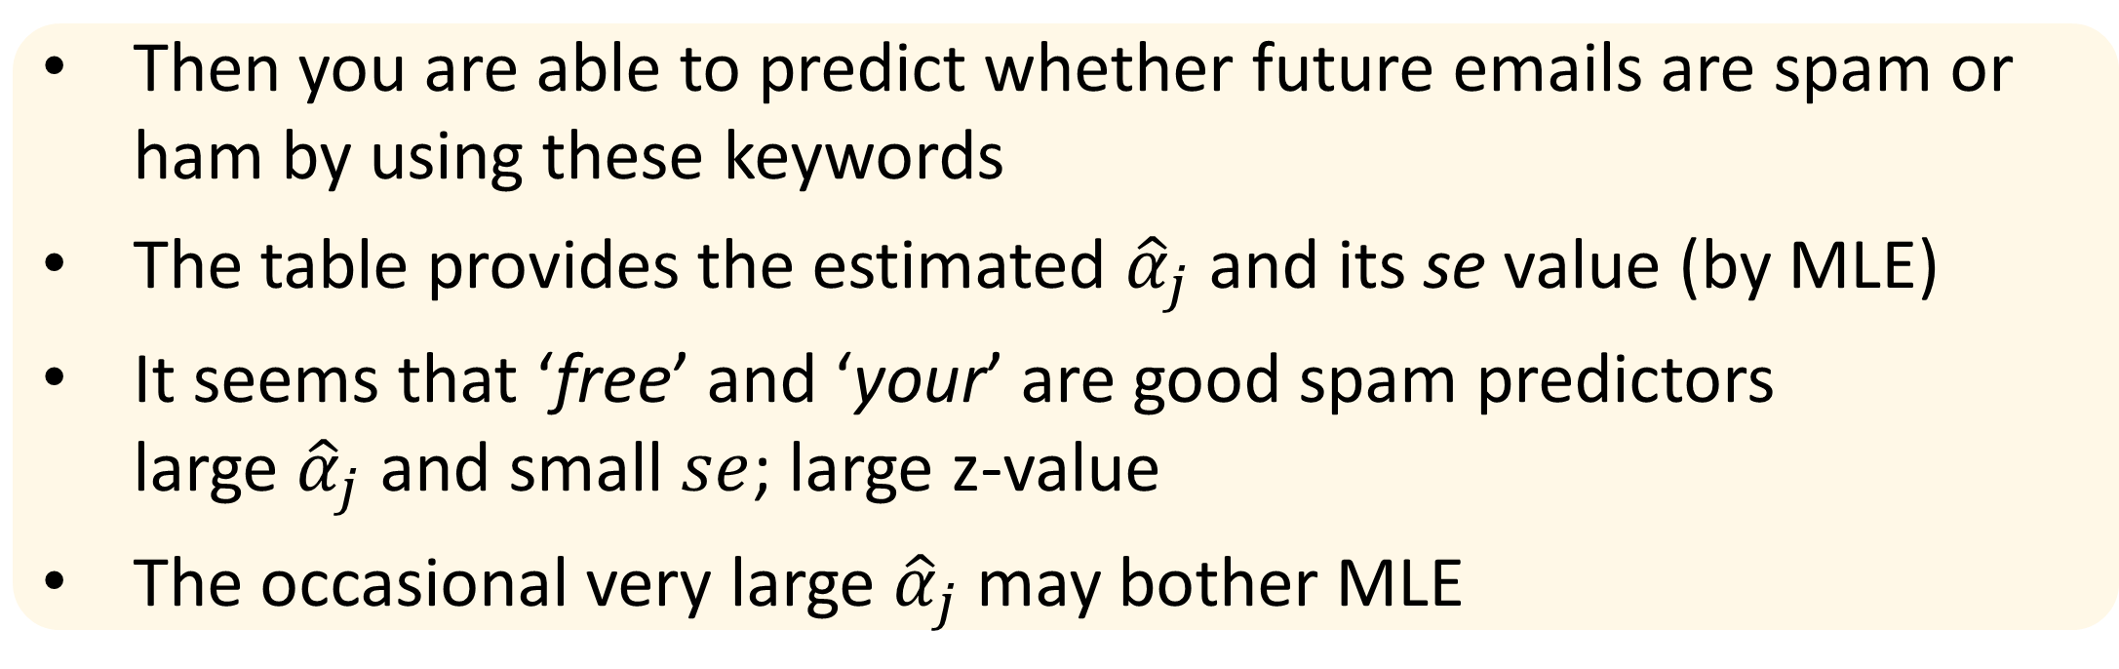
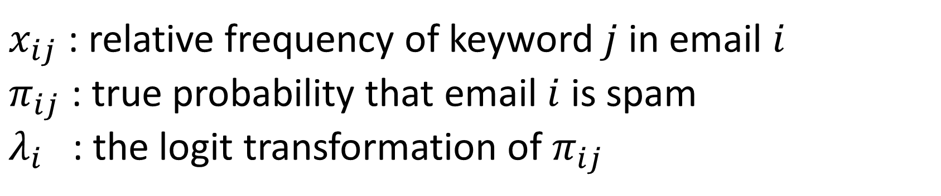
Example : spam filter
$\frac{{\hat{α}}_{j}}{se}$
George labeled $N$=4601 emails whether spam or ham(i.e. non-spam)
He used 57 words as predictors in the table.
$x_{ij}$ : relative frequency of keyword $j$ in email $i$
$π_{ij}$ : true probability that email $i$ is spam
$λ_{i}$ : the logit transformation of $π_{ij}$
$λ_{ij}=\log\left\{\frac{π_{ij}}{1−π_{ij}}\right\}=α_{0}+$ $\sum_{j=1}^{57}{α_{j}x_{ij}}$
Then you are able to predict whether future emails are spam or ham by using these keywords
The table provides the estimated ${\hat{α}}_{j}$ and its se value (by MLE)
It seems that ‘free’ and ‘your’ are good spam predictors large ${\hat{α}}_{j}$ and small $se$; large z-value
The occasional very large ${\hat{α}}_{j}$ may bother MLE

Slide 12
THANK YOU
Q&A

